Slide 1








IndiaSkills Competition 2025
WorldSkills Competition 2026
Andhra Pradesh

Slide 2
Introduction
India’s premier national vocational skills competition
Showcasing India's Talent on a Global Stage
Organized by MSDE / NSDC
Affiliated with WorldSkills International
Part of the "Skill India" initiative
Notes:
Please indicate the hiring

Slide 3
WorldSkills Competition
Founded in 1950, WorldSkills is a global organisation that promotes vocational, technological, and service-oriented education and training. ​
WorldSkills promotes skilled careers in 86 Member countries and regions, all working with youth, educators, governments, and industries to help prepare the workforce and talent of today for the jobs of the future.​
WorldSkills Competition is a biennial Competition. ​
The last WorldSkills Competition took place in 2024 at Lyon - France, and the next competition is planned in 2026 at Shanghai, China.
Notes:
Please indicate the hiring

Slide 4
Students Registration
63 Skill categories across sectors
Open to all 36 States & UTs
Age eligibility:
Born on/after 01-Jan-2004 (General Skills)
Born on/after 01-Jan-2001 (Advanced tech skills)
Register on Skill India Digital Hub (SIDH)
https://www.skillindiadigital.gov.in/account/register?returnUrl=%2Findia-skills-2025
Deadline: 30th September 2025
Notes:
Please indicate the hiring

Slide 5
Selection Process
Track I: State Level by SSDMs
Track II: SSC-led for non-SSDM skills
Leads to:
Regional Level Competitions
Bootcamps
National Level Competitions
Notes:
Please indicate the hiring

Slide 6
Competition Timelines
Stage | Timeline
Registration Opens | July 2025
Last Date for students registration | 30 Sept 2025
State / SSC Level Competitions | Sept – Nov 2025
Regional Level Competitions | Dec 2025
National Level Competitions | Feb 2026
WorldSkills Competitions Preparation | Feb – Sept 2026
WorldSkills Competitions | 22nd to 27th Sept 2026
Notes:
Please indicate the hiring

Slide 7
Benefits to Competitors
National Recognition as Skill Champions
Chance to represent India at WorldSkills 2026
Skill training, bootcamps, mentorship
Industry Exposure
Career visibility/progression and placements
Notes:
Please indicate the hiring

Slide 8
NSQF alignment and Creditization:
S. No | Type of Certificate | Stage | Certification | Percentage of Total Credit accumulated at this level | Credit allocation percentage | Credits published on the Certificate (rounded off)
1 | District Level | District Level Competition | By concerned SSC | 10% | 10% | 2
2 | State Level | State Level Competition | By concerned SSC | 20% | 30% (10+20) | 5
3 | Regional Level | Regional Level Competition | By concerned SSC | 30% | 60% (10+20+30) | 10
4 | National Level | National Level Competition | By concerned SSC | 40% | 100% (10+20+30+40) | 17
Notes:
Please indicate the hiring

Slide 9
Stakeholders & Roles
MSDE / NSDC: Policy, Coordination, Regional and National Level Competitions
SSDMs / SSCs: District and State Level Competitions
Industry / TPs: Training, Infrastructure, Mentors, Jury
Notes:
Please indicate the hiring

Slide 10
Plan of Action
For Government / Institutions:
Promote registrations via SIDH
Schedule & host local competitions
Support bootcamps and mentoring
For Participants:
Register before 30th Sept 2025 via SIDH
Choose skill category
Prepare via training centers
Notes:
Please indicate the hiring

Slide 11
List of Skills – 1/8
S No | Skill Name | Age Eligibility | Category | Format
1 | Bricklaying | Born on or after 1 Jan 2004 | Official | Individual
2 | Cabinetmaking | Born on or after 1 Jan 2004 | Official | Individual
3 | Carpentry | Born on or after 1 Jan 2004 | Official | Individual
4 | Concrete Construction Work | Born on or after 1 Jan 2004 | Official | Team
5 | Electrical Installations | Born on or after 1 Jan 2004 | Official | Individual
6 | Joinery | Born on or after 1 Jan 2004 | Official | Individual
7 | Landscape Gardening | Born on or after 1 Jan 2004 | Official | Team
8 | Painting and Decorating | Born on or after 1 Jan 2004 | Official | Individual
Notes:
Please indicate the hiring

Slide 12
List of Skills – 2/8
S No | Skill Name | Age Eligibility | Category | Format
9 | Plastering and Drywall Systems | Born on or after 1 Jan 2004 | Official | Individual
10 | Plumbing and Heating | Born on or after 1 Jan 2004 | Official | Individual
11 | Refrigeration and Air Conditioning | Born on or after 1 Jan 2004 | Official | Individual
12 | Wall and Floor Tiling | Born on or after 1 Jan 2004 | Official | Individual
13 | 3D Digital Game Art | Born on or after 1 Jan 2004 | Official | Individual
14 | Fashion Technology | Born on or after 1 Jan 2004 | Official | Individual
15 | Floristry | Born on or after 1 Jan 2004 | Official | Individual
16 | Graphic Design Technology | Born on or after 1 Jan 2004 | Official | Individual
Notes:
Please indicate the hiring

Slide 13
List of Skills – 3/8
S No | Skill Name | Age Eligibility | Category | Format
17 | Jewellery | Born on or after 1 Jan 2004 | Official | Individual
18 | Visual Merchandising | Born on or after 1 Jan 2004 | Official | Individual
19 | Digital Interactive Media | Born on or after 1 Jan 2004 | Provisional | Individual
20 | IT Network Systems Administration | Born on or after 1 Jan 2004 | Official | Individual
21 | Software Application Development | Born on or after 1 Jan 2004 | Official | Individual
22 | Mobile Applications Development | Born on or after 1 Jan 2004 | Official | Individual
23 | Web Technologies | Born on or after 1 Jan 2004 | Official | Individual
24 | Intelligent Security Technology | Born on or after 1 Jan 2004 | Provisional | Individual
Notes:
Please indicate the hiring

Slide 14
List of Skills – 4/8
S No | Skill Name | Age Eligibility | Category | Format
25 | Software Testing | Born on or after 1 Jan 2004 | Provisional | Individual
26 | Autonomous Mobile Robotics | Born on or after 1 Jan 2004 | Official | Team
27 | Chemical Laboratory Technology | Born on or after 1 Jan 2004 | Official | Individual
28 | CNC Milling | Born on or after 1 Jan 2004 | Official | Individual
29 | CNC Turning | Born on or after 1 Jan 2004 | Official | Individual
30 | Electronics | Born on or after 1 Jan 2004 | Official | Individual
31 | Industrial Control | Born on or after 1 Jan 2004 | Official | Individual
32 | Industrial Mechanics | Born on or after 1 Jan 2004 | Official | Individual
Notes:
Please indicate the hiring

Slide 15
List of Skills – 5/8
S No | Skill Name | Age Eligibility | Category | Format
33 | Mechanical Engineering CAD | Born on or after 1 Jan 2004 | Official | Individual
34 | Renewable Energy | Born on or after 1 Jan 2004 | Official | Individual
35 | Welding | Born on or after 1 Jan 2004 | Official | Individual
36 | Unmanned Aerial Systems | Born on or after 1 Jan 2004 | Provisional | Individual
37 | Bakery | Born on or after 1 Jan 2004 | Official | Individual
38 | Beauty Therapy | Born on or after 1 Jan 2004 | Official | Individual
39 | Cooking | Born on or after 1 Jan 2004 | Official | Individual
40 | Hairdressing | Born on or after 1 Jan 2004 | Official | Individual
Notes:
Please indicate the hiring

Slide 16
List of Skills – 6/8
S No | Skill Name | Age Eligibility | Category | Format
41 | Health and Social Care | Born on or after 1 Jan 2004 | Official | Individual
42 | Hotel Reception | Born on or after 1 Jan 2004 | Official | Individual
43 | Pâtisserie and Confectionery | Born on or after 1 Jan 2004 | Official | Individual
44 | Restaurant Service | Born on or after 1 Jan 2004 | Official | Individual
45 | Retail Sales | Born on or after 1 Jan 2004 | Provisional | Individual
46 | Autobody Repair | Born on or after 1 Jan 2004 | Official | Individual
47 | Automobile Technology | Born on or after 1 Jan 2004 | Official | Individual
48 | Car Painting | Born on or after 1 Jan 2004 | Official | Individual
Notes:
Please indicate the hiring

Slide 17
List of Skills – 7/8
S No | Skill Name | Age Eligibility | Category | Format
49 | Heavy Vehicle Technology | Born on or after 1 Jan 2004 | Official | Individual
50 | Logistics and Freight Forwarding | Born on or after 1 Jan 2004 | Official | Individual
51 | Digital Construction | Born on or after 1 Jan 2001 | Official | Individual
52 | Cloud Computing | Born on or after 1 Jan 2001 | Official | Individual
53 | Cyber Security | Born on or after 1 Jan 2001 | Official | Team
54 | ICT Network Infrastructure | Born on or after 1 Jan 2001 | Official | Individual
55 | Additive Manufacturing | Born on or after 1 Jan 2001 | Official | Individual
56 | Industrial Design Technology | Born on or after 1 Jan 2001 | Official | Individual
Notes:
Please indicate the hiring

Slide 18
List of Skills – 8/8
S No | Skill Name | Age Eligibility | Category | Format
57 | Industry 4.0 | Born on or after 1 Jan 2001 | Official | Team
58 | Mechatronics | Born on or after 1 Jan 2001 | Official | Team
59 | Optoelectronic Technology | Born on or after 1 Jan 2001 | Official | Individual
60 | Robot Systems Integration | Born on or after 1 Jan 2001 | Official | Team
61 | Water Technology | Born on or after 1 Jan 2001 | Official | Individual
62 | Dental Prosthetics | Born on or after 1 Jan 2001 | Provisional | Individual
63 | Aircraft Maintenance | Born on or after 1 Jan 2001 | Official | Individual
Notes:
Please indicate the hiring

Slide 19



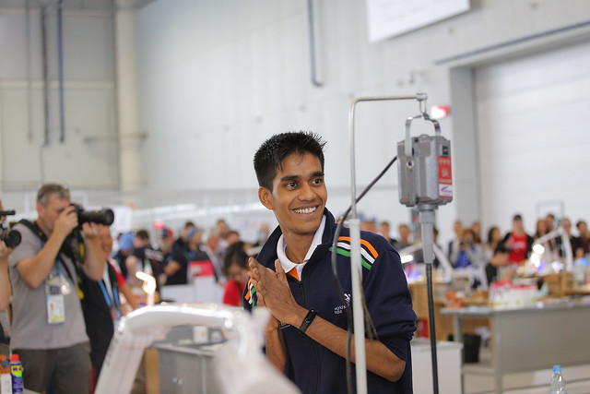
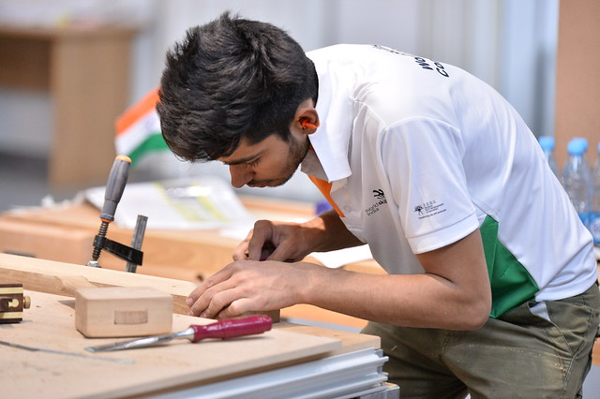
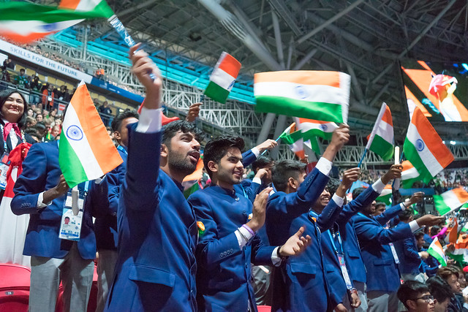
Photo Gallery - Competition
Notes:
Please indicate the hiring

Slide 20
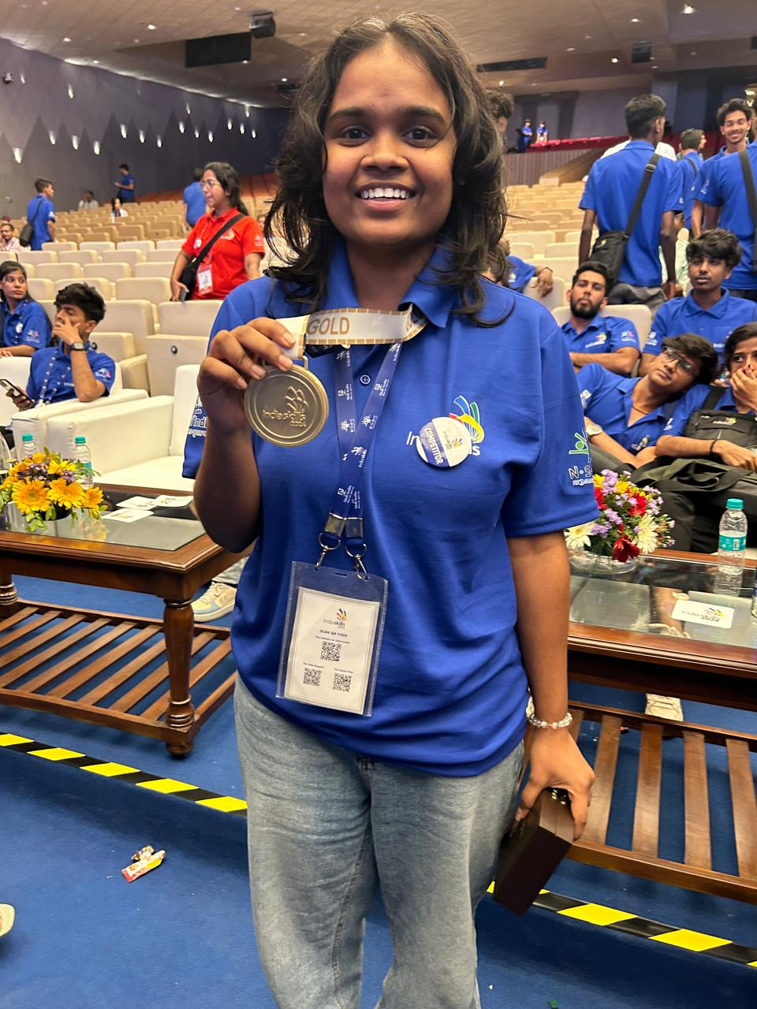
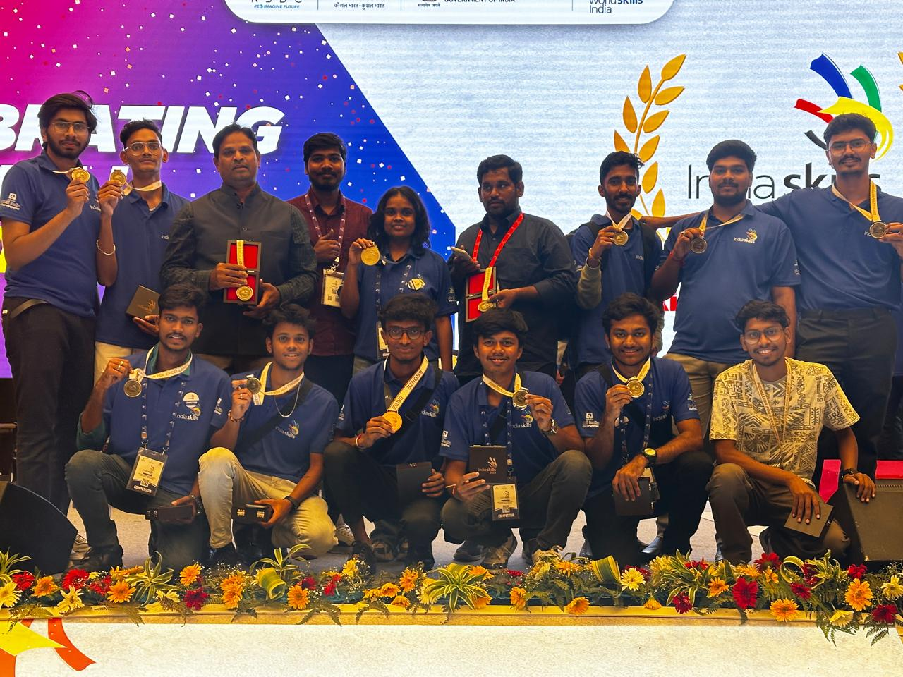
Achievement at India Skills Competition – 2024
Ms. Harshita Nukasani had won the “Gold” medal in Cosmetic Design skill at India Skill Competition 2024, New Delhi, India.
Mr. Giri Prasadh Reddy had won the “Bronze” medal in Mechatronics skill at India Skill Competition 2024, New Delhi, India.
Won another "Medallion of Excellence" medal in multiple skills at India Skill Competition 2024, New Delhi, India.
Notes:
Please indicate the hiring

Slide 21
Guidelines & Test Papers
IndiaSkills & WorldSkills Competitions 2025 Guidelines
WorldSkills India | Home
List of Skills 2025
WorldSkills India | Home
Model Test Projects
Test Projects-WorldSkills Competiton -2024 – OneDrive
Videos
WorldSkills India | Home
Notes:
Please indicate the hiring

Slide 22
Skill Competition Videos
https://www.instagram.com/reel/DM2ayVoB9bo/?igsh=OGlmdDB3d3Jid3J6
https://www.instagram.com/reel/DMaokjHNMlW/?igsh=MXNsbWhkN203OHZ6OQ==
https://www.instagram.com/reel/DAdcTIAPqmo/?igsh=Mmlxbms0MGJ4aXFt
https://www.instagram.com/reel/DAa4N2cvJXK/?igsh=cHRzbzlvdWNsN3Rk
Notes:
Please indicate the hiring

Slide 23
Best Wishes
A platform to empower youth through skills, training, and global exposure.
Represent India at the World Stage!
Notes:
Please indicate the hiring

Slide 24
Thank you

